Slide 1

Introduction to Computer Science Using R: A Course for Analysts
Lesson 4: Vector & Matrix Operations

Slide 2
References & Texts
I recommend the following resources, which I have made copious use of in developing this material:
Paul D. Crutcher, Neeraj Kumar Singh, and Peter Tiegs
Essential Computer Science, A Programmer’s Guide to Foundational Concepts
APress / Springer Nature, 2021 https://doi.org/10.1007/978-1-4842-7107-0
Garrett Grolemund
Hands On Programming in R
O'Reilly and Associates, 2014 http://bit.ly/HandsOnR
Homer White
Beginning Computer Science with R
Georgetown College https://homerhanumat.github.io/r-notes/index.html

Slide 3
Data Structures and Variable Review

Slide 4
# Good variable names
# All variables are objects!
# You can re-use a name, but you will over-write the object.
a <- “Once upon a time.”
b <- 22
mylist <- c(1, 2, 45)
_first <- 123.54
# Variable names that will result in errors
^Fourteen <- “14 carat”
1234 <- “hello”
# Naming rule: a name cannot start with a number and a name cannot
# use some special symbols, like ^, !, $, @, +, -, /, or *
Name = “George”
name = “Pablo”
print(name)
Variable Naming in R
Names are case-sensitive
Do not start an object name with a number or a special symbol (like ^, !, $, @, +, -, /, or *).

Slide 5
# Common Data Structures
Vector <- c(1,2,3,4) # a sequence of items of the same type
print(Vector[1])
1
List <- c(1, “one”, 1.1) # sequence of items of many types
print(List[3])
1.1
# A few basic ways to create a matrix in R:
MatrixA <- matrix(1:9, nrow = 3, ncol = 3)
MatrixA <- matrix(1:9, nrow = 3) #Equivalent
print(MatrixA)
[,1] [,2] [,3]
[1,] 1 4 7
[2,] 2 5 8
[3,] 3 6 9
MatrixB <- matrix(1:9, nrow = 3, byrow=TRUE)
print(MatrixB)
[,1] [,2] [,3]
[1,] 1 2 3
[2,] 4 5 6
[3,] 7 8 9
# Easiest way to create a data frame
Name <- c("Jon", "Bill", "Maria", "Ben", "Tina")
Age <- c(23, 41, 32, 58, 26)
DataFrame <- data.frame(Name, Age)
Common R Data Structures
We know about types, such as character, integer and float.
But these are commonly combined into data structures such as vectors and lists.
R has several commonly-use data structures, and vectors are the most common. In fact, R is a vector-based language, in that scalar values in R are considered vectors of unit-length.

Slide 6
Introduction (or Reintroduction) to Vectors

Slide 7
What are vectors? (a review)
It depends on who you ask ☺
Three perspectives:
PHYSICS
They are arrows pointing in space
Length and direction define them
Can be 2 or 3 dimensional
COMPUTER SCIENCE / STATISTICS
Ordered lists of numbers that represent information
About a process you want to model
Fancy word for list, # of dimensions = # of data points
MATH
Can be anything, as long as you can add or multiply them
Reference: 3Blue1Brown – Essence of Linear Algebra

Slide 8
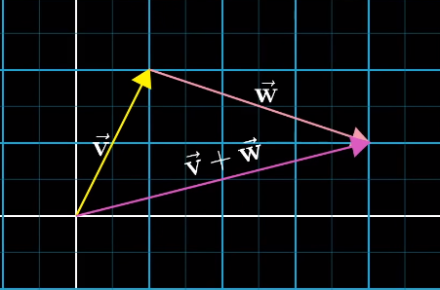
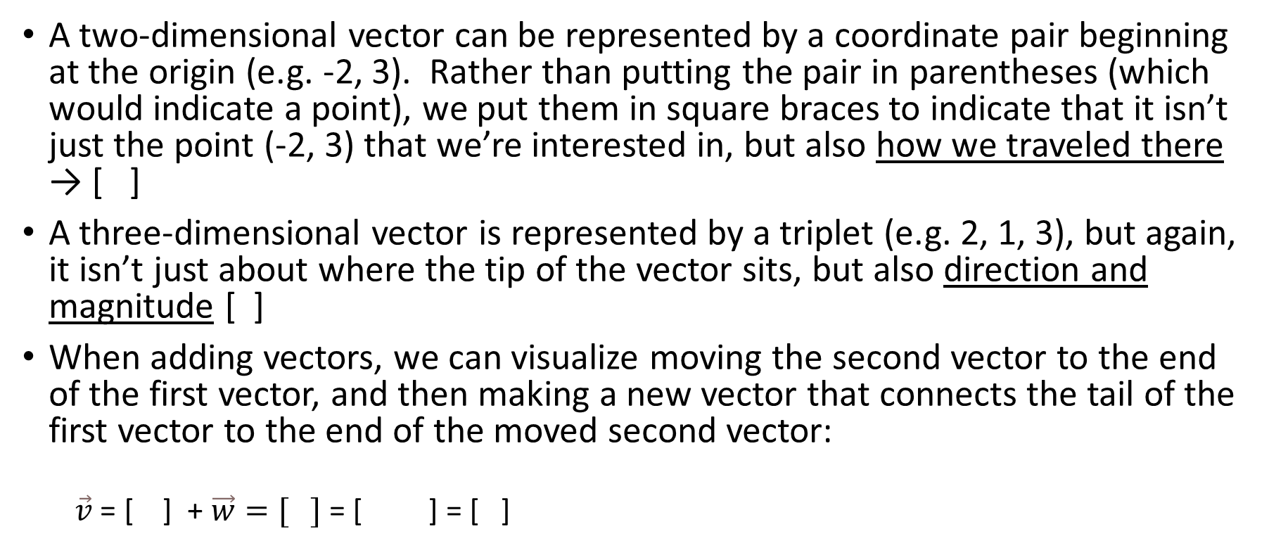
Vector Representations
A two-dimensional vector can be represented by a coordinate pair beginning at the origin (e.g. -2, 3). Rather than putting the pair in parentheses (which would indicate a point), we put them in square braces to indicate that it isn’t just the point (-2, 3) that we’re interested in, but also how we traveled there → [ ]
A three-dimensional vector is represented by a triplet (e.g. 2, 1, 3), but again, it isn’t just about where the tip of the vector sits, but also direction and magnitude [ ]
When adding vectors, we can visualize moving the second vector to the end of the first vector, and then making a new vector that connects the tail of the first vector to the end of the moved second vector:
$\vec{v}$ = [ ] + $\vec{w}=[ ]$ = [ ] = [ ]
-2
3
2
1
3
1
2
3
-1
1 + 3
2 + -1
4
1
Image: 3Blue1Brown

Slide 9
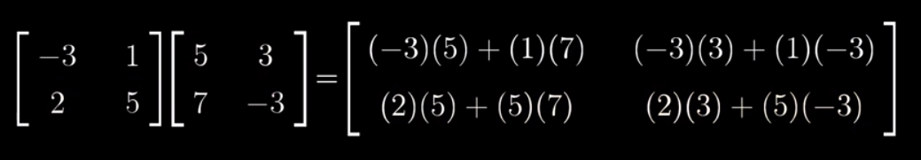
Vector Transformations: Matrix Representations
Linear transformation: Multiplying a matrix by a vector; transforms the locations of the vectors in space. You can do this more than one time.
Matrix multiplication as linear transformation: You can represent the arrival point of a linear transformation as a matrix, and a series of arrival points as a series of matrices. If you combine them together using multiplication, the composition of the two matrices becomes a matrix that represents a “short cut” to the final arrival location of the vector. See this video for more.
Image: 3Blue1Brown

Slide 10
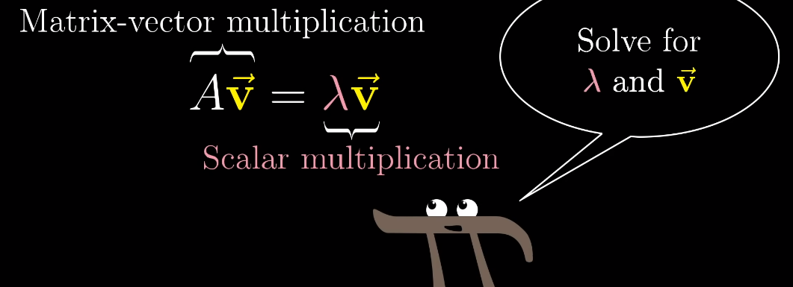
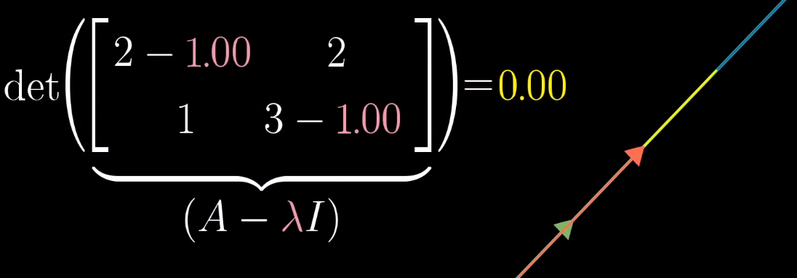
A few more matrix-related items
Determinant – the factor by which a linear transformation scales an area or inverts & scales an area. The transformation that reduces an area such that dimensionality is reduced, has a determinant of zero.
Eigenvectors – special vectors that don’t get “knocked off their original span” by a linear transformation, instead they are scaled by their Eigenvalues (the factors by which they are flipped, scaled or squished during their linear transformation).
Images: 3Blue1Brown

Slide 11

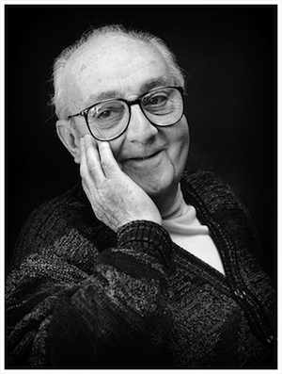
Relationship to Statistics & Machine Learning
Many statistical techniques used on multivariate linear data (data where there are many predictor variables that have a linear relationship with one another) involve the reduction of dimensionality of data – sometimes for the purpose of finding commonalities between data points (as in Factor Analysis), other times for the purpose of finding a way to represent a data set with many dimensions in a lower-dimensional way (as in Principal Component Analysis)
These techniques involve computation – using R, python, SAS or GUI software – of the eigenvectors and eigenvalues of a matrix of variables. This makes a lot of sense – we can reduce the dimensionality of related data through identification of values that make the determinant zero! (Yes, some data is lost when these techniques are used, but models made using them can still be very useful.)
Please don’t
quote me again!

Slide 12
Vector & Matrix Manipulation in R

Slide 13
# Matrix Creation in R
# Using ‘dimnames’ to name the rows & columns of a matrix
X <- matrix(1:9, nrow = 3, dimnames = list(c("X","Y","Z"), c("A","B","C")))
print(X)
A B C
X 1 4 7
Y 2 5 8
Z 3 6 9
# Accessing the row & column names using ‘colnames’ and ‘rownames’
print(colnames(X))
"A" "B" "C"
print(rownames(X))
"X" "Y" "Z“
# Changing the row & column names by assigning to colnames or rownames
colnames(X) <- c("C1","C2","C3")
rownames(X) <- c("R1","R2","R3")
print(X)
C1 C2 C3
R1 1 4 7
R2 2 5 8
R3 3 6 9
# Creating a matrix using ‘cbind’ or ‘rbind’
cbind(c(1,2,3),c(4,5,6))
[,1] [,2]
[1,] 1 4
[2,] 2 5
[3,] 3 6
rbind(c(1,2,3),c(4,5,6))
[,1] [,2] [,3]
[1,] 1 2 3
[2,] 4 5 6
More ways to create a matrix
First, a review of the ways on Slide 5.
Other ways:
Call matrix()
Use cbind() or rbind()
Create a matrix from a vector
# More Matrix Creation in R
# Create a Matrix from a Vector using ‘dim’
V <- c(1,2,3,4,5,6)
class(V)
"numeric"
dim(V) <- c(2,3)
print(V)
[,1] [,2] [,3]
[1,] 1 3 5
[2,] 2 4 6
class(V)
"matrix"

Slide 14
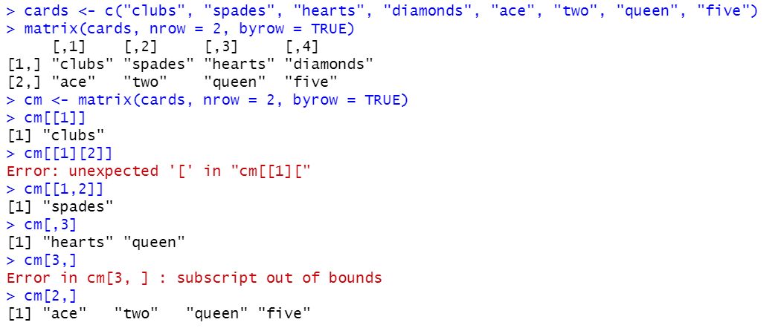
Accessing the Elements of a Matrix
Just as there are several ways to create a matrix, there are several ways to access elements of a matrix.
The code below creates a matrix of character type objects, or strings.
You can index a single element using matrixname[[1]] for individual elements. You can also use matrixname[[1,2]].
You can access a ‘column’ as a vector using matrixname[,n] where n is the column number (Remember: R starts indexing with 1, not 0 ☺), provided that that column exists.
If you use [n,], that accesses a row as a vector (provided it exists). See below for an example of what happens when it doesn’t.
Finally, you can use subtractive notation (matrixname[,-1] or [-1,]) to select all rows or columns *except* one.
Not quite the
same syntax
Tried to access a
row that doesn’t
exist
Vectors

Slide 15
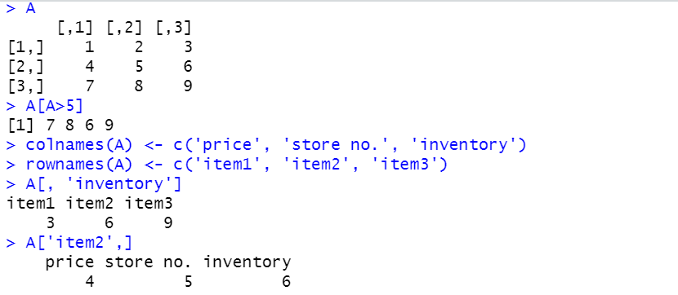
More on Accessing Elements
The rows and columns of a matrix can be given names, using the rownames and colnames functions. In a matrix with names, rows and columns can be indexed using the names, rather than index positions.
A matrix can also be indexed conditionally, using an expression that filters some of the elements.
Conditional indexing
Acessing via
column or row
names
Vectors

Slide 16
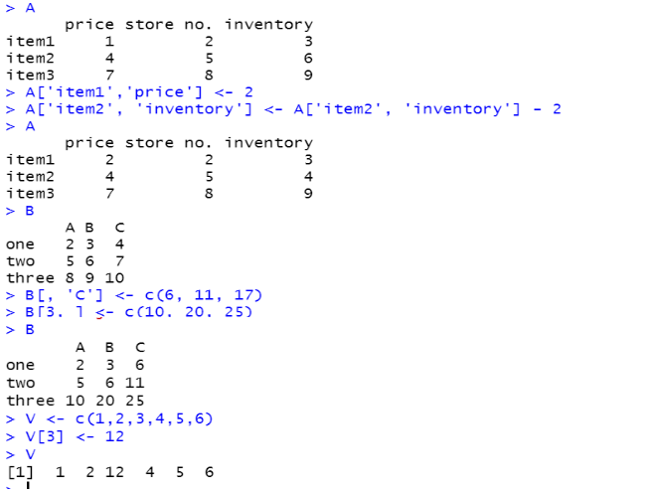
Modifying Elements
In a manner similar to accessing elements, elements can also be modified. Just use the usual <- R assignment operator you’ve seen in earlier lessons!
Modifying via
column or row
names
Modifying by
position

Slide 17
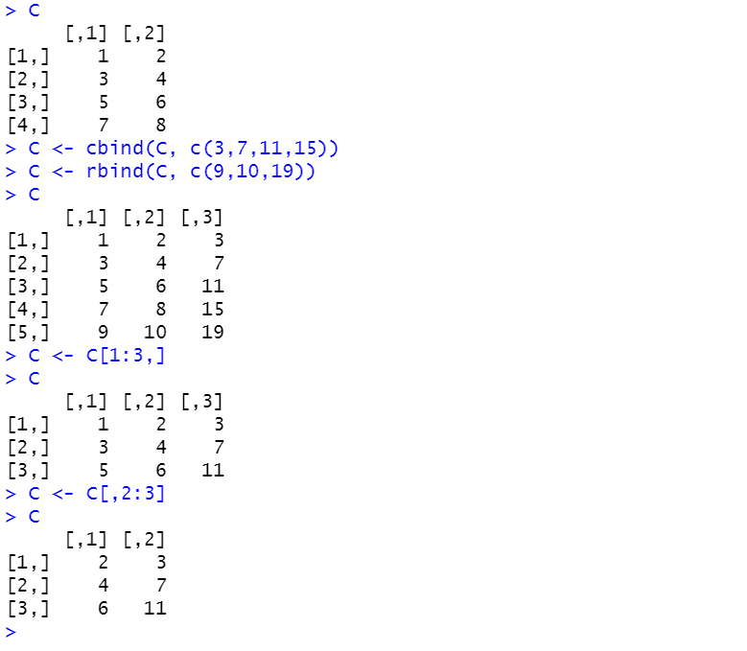
Adding and Removing Rows and Columns
What about adding a new row or column? The functions used to perform this action are called rbind (for row-bind) and cbind (for column-bind).
Rows or columns can also be removed through re-assignment.
Adding a column,
adding a row
Removing 2 rows by assignment,
removing a column by assignment

Slide 18
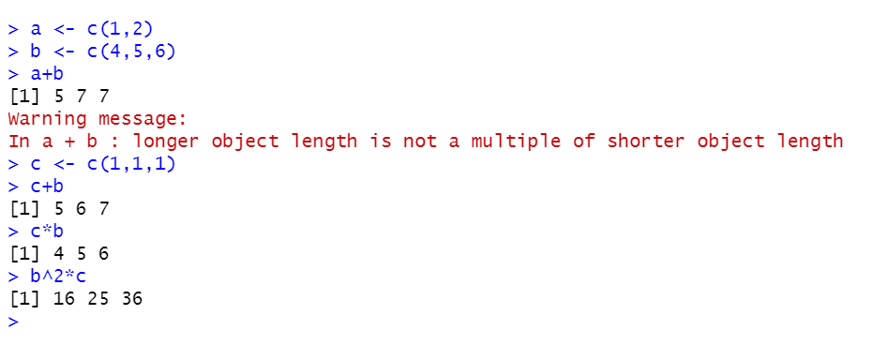
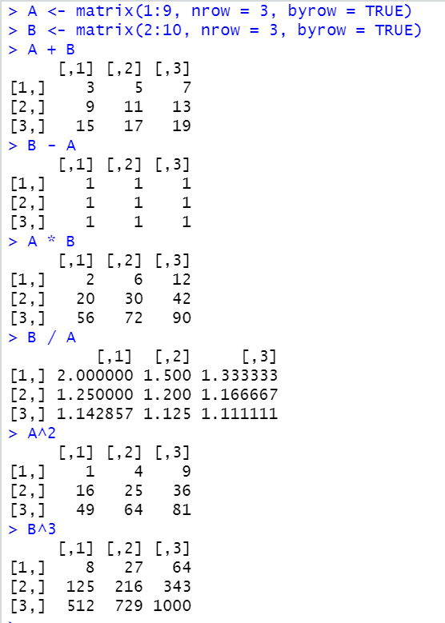
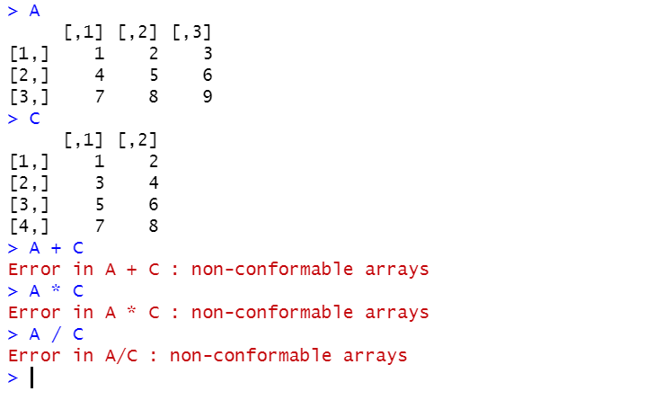
Performing element-wise calculations using vectors and matrices
These types of calculations are handy to perform using vectors and matrices, but those familiar with linear algebra may find them confusing. Just remember: ‘regular’ operators (such as +, -, *, / and ^) perform the same / ‘typical’ transformations on vectors and matrices that they perform on all other operands.

Slide 19
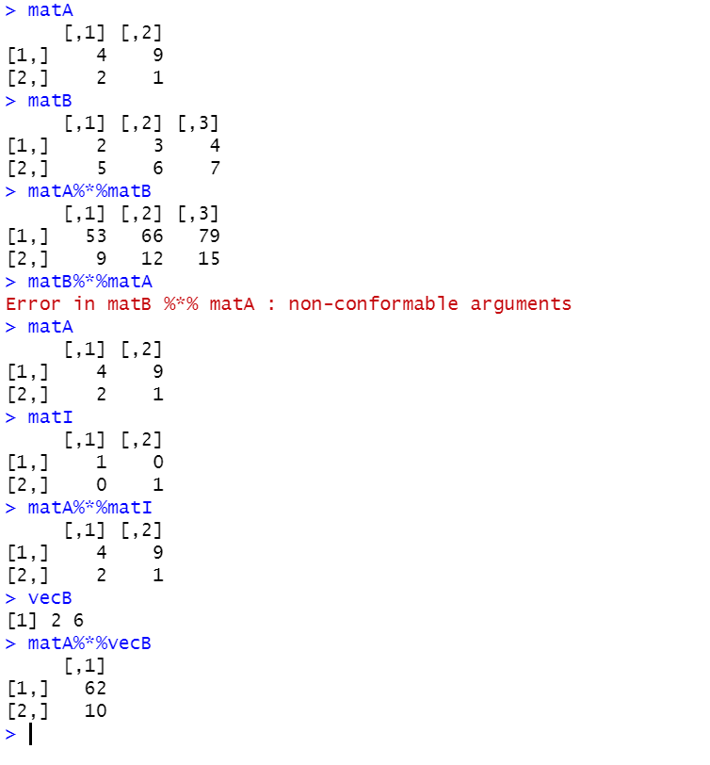
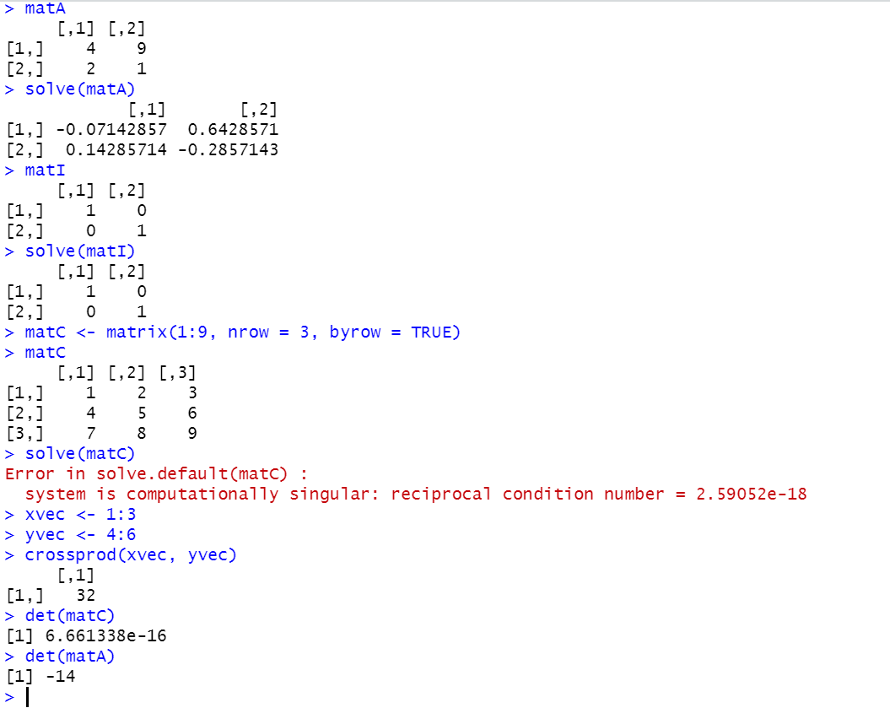
Vector and Matrix Manipulation
Taking the transpose (not illustrated below) is done with t(matA). Functions shown below: performing matrix/matrix and matrix/vector multiplication, computing the crossproduct of two vectors (crossprod), creating an identity matrix, and finding the inverse (using the ‘solve’ command) and the determinant (using ‘det’).
A matrix (mxn) can only
be multiplied by a matrix (nxp)
Inverse of matA
Inverse of identity is itself
An identity matrix,
created with diag(2)
No inverse computable for matC
Determinant essentially 0
Determinant non-zero

Slide 20
Homework – Lesson 4
The Jacobi Method
INTRODUCTION
A system of equations, Ax = b, can be represented by:
A matrix A
A vector x of unknowns / independent variable-values,
and a vector b of outcomes
There are several iterative ways to solve such a system. One way, which works on square, diagonally-dominant systems, is the Jacobi method, named for German mathematician Carl Jacobi. The Jacobi method is a type of 'splitting method', where the results of one iteration are fed back into the equation for the next iteration until one of the following outcomes is achieved:
Convergence is reached, and an x vector solution is found
A threshold difference between the k and k+1 values is reached (ie. it is determined that guesses for the values of vector x are 'close enough' to vector x's true solution)
A maximum number of iterations has been performed, but no acceptably accurate solution for vector x has been found
A proof is available here: https://sites.lsa.umich.edu/shixumeng/wp-content/uploads/sites/629/2020/04/Lec-7.3-part-1.pdf
REMINDER
In linear equation systems, there are the the following possibilities:
The system has 1 solution
The system has infinite solutions (with 1 or more unknowns)
The system has no solution / represents an impossible claim

Slide 21
Homework – Lesson 4
The Jacobi Method (continued)
DESCRIPTION:
Write an R function that performs the Jacobi method, and takes the arguments A (a matrix), b (a vector), x (an optional vector), a number of iterations, and a convergence threshold (e.g. .0001) such that:
Ax = b is a diagonally-dominant square system of n linear equations where:
The number of unknowns is equal to the number of equations (the order is nxn)
A is a matrix of coefficient values for all equations in the system
For each row in A, |aii| > |sum(all aij)|
x is a vector of unknowns for each equation in the system for which the user supplies an initial guess
b is a vector of right sides for all equations in the system
Convergence is determined by the Euclidean norm between two subsequent solutions ||x(k-1)-x(k)||2 < a supplied tolerance level (convergence threshold)
The user will have the opportunity to tell the iterator how many times to run before giving up on finding a solution (number of iterations)
If the iterator finds the solution before the maximum (or default maximum) number of iterations has been reached, a result will be given early
For each iteration specified: until convergence is reached: the value of the next x-guess, x(k+1) = the Inverse(Diagonal(A)) * (b - (Remainder(Diagonal(A)) * the value of the current x-guess, x(k)

Slide 22
Homework – Lesson 4
The Jacobi Method (continued)
AN EXAMPLE OF THE FUNCTION IN PYTHON (written by me):
import numpy as np
def jacobi(A, b, x=None, iters=50, conv_thresh=.0001):
if x is None: x = np.zeros(len(A[0]))
abs_a = np.abs(A)
if np.all(2 * np.diag(abs_a) >= np.sum(abs_a, axis=1)) and A.shape[0] == A.shape[1]:
D = np.diag(A)
R = A - np.diagflat(D)
reached = 0
for i in range(iters):
x_next = (b - np.dot(R, x))/D
if np.linalg.norm(x_next - x) < conv_thresh or (x_next == x).all():
reached = 1
x = x_next
if reached == 1:
print("The solution: " + str(x_next))
print("The solution was found in " + str(i) + " iterations.")
return
if reached == 0:
print("No solution was found in " + str(iters) + " iterations.")
print("x is currently: " + str(x))
return
else:
print("The matrix is not diagonally dominant or the matrix is not square.
Please use another method.")
return

